Slide 1
Bio-informatics exercises 2nd – Bachelor BMW
Part I: Information retrieval

Slide 2
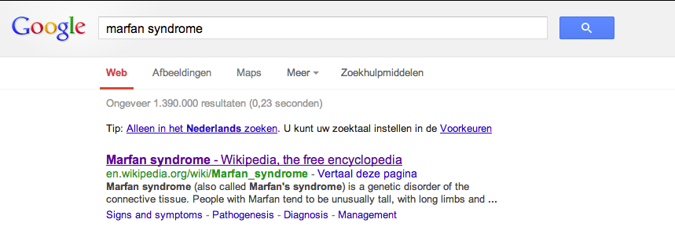
Step 1: Finding the gene associated with a disease
· What is Marfan syndrome? What are the phenotypic traits of Marfan syndrome?
· What is the cause of Marfan syndrome? Run a Google search.
Marfan syndrome (also called Marfan's syndrome) is a genetic disorder of the connective tissue. People with Marfan tend to be unusually tall, with long limbs and long, thin fingers.
The syndrome is inherited as a dominant trait, carried by the gene FBN1, which encodes the connective protein fibrillin-1.^{[1][2]} People have a pair of FBN1 genes. Because it is dominant, people who have inherited one affected FBN1 gene from either parent will have Marfan syndrome.
Marfan syndrome has a range of expressions, from mild to severe. The most serious complications are defects of the heart valves and aorta. It may also affect the lungs, the eyes, the dural sac surrounding the spinal cord, the skeleton and the hard palate

Slide 3
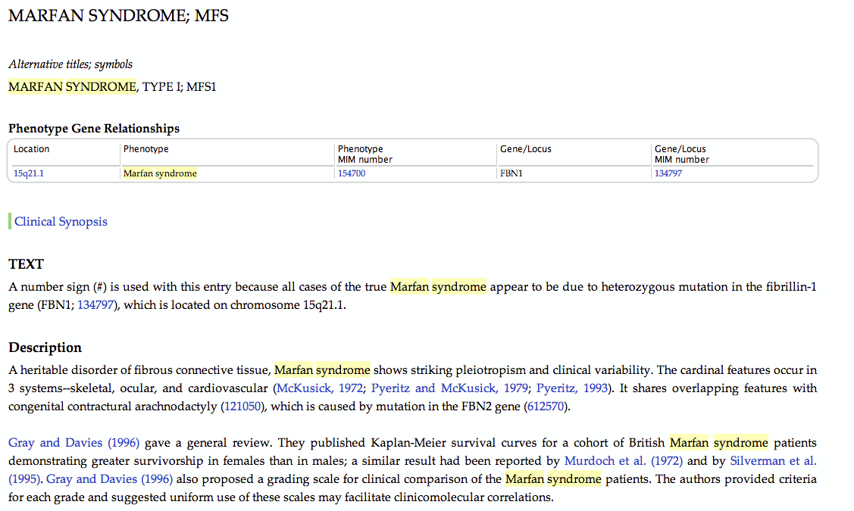
QUESTIONS:
What is your disease associated gene?
FBN1 - gene
· Go to the OMIM database and search for Marfan syndrome. Do you find the same gene?

Slide 4
Step 2: Get more information about your gene
· Check the links in your OMIM gene page for more information
1. What is the Ensembl Gene ID of your gene?
ENSG00000166147

Slide 5
2. How many different transcripts are there for your gene according to Ensembl database, how many of them are translated?
There are 8 transcripts, 4 of which are translated

Slide 6
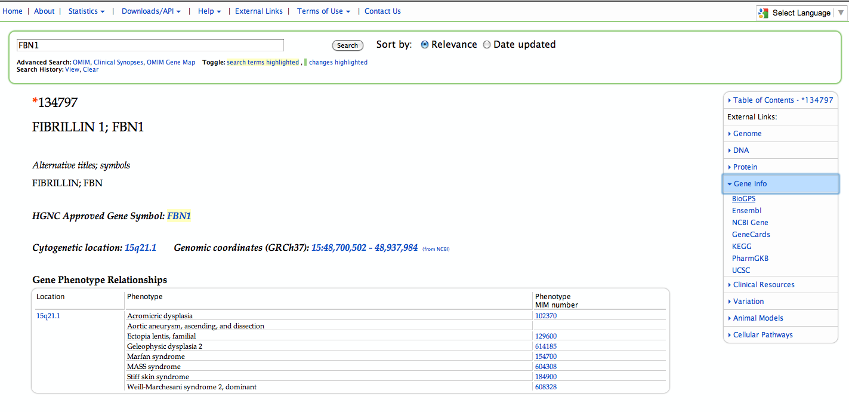
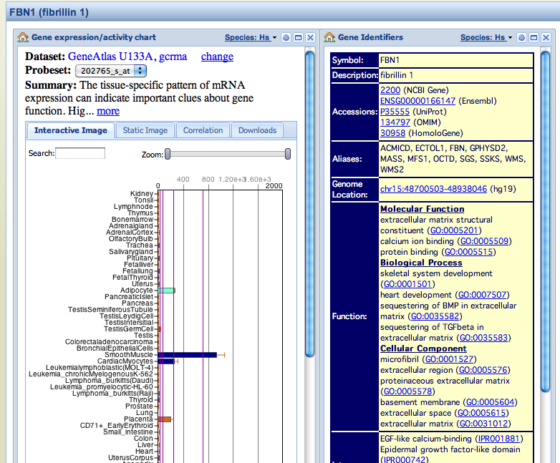
3. In which tissue does your gene have a high expression?
Smooth muscle , cardiomyocytes, adipocytes placenta

Slide 7
4. What are the other diseases that your gene is associated with?

Slide 8
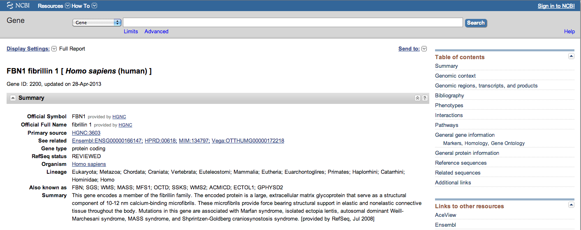
Check the links in your NCBI gene page for more information
1. What is the Gene ID of your gene in NCBI database?
Gene ID: 2200

Slide 9
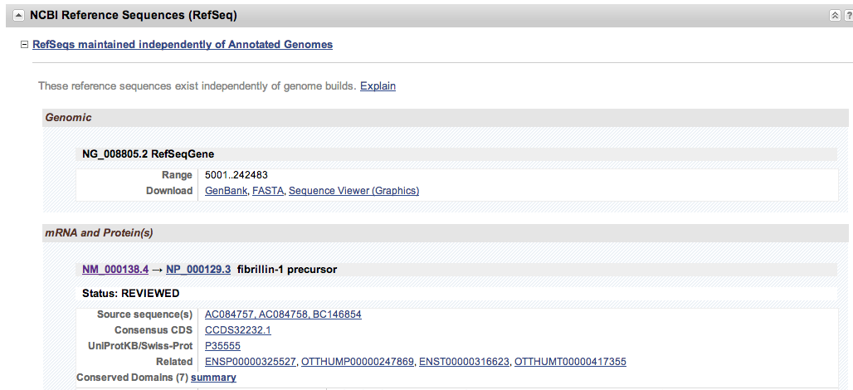
2. What is the RefSeq Gene ID of your gene?
Scroll down on the NCBI gene page until you reach the NCBI reference sequence

Slide 10
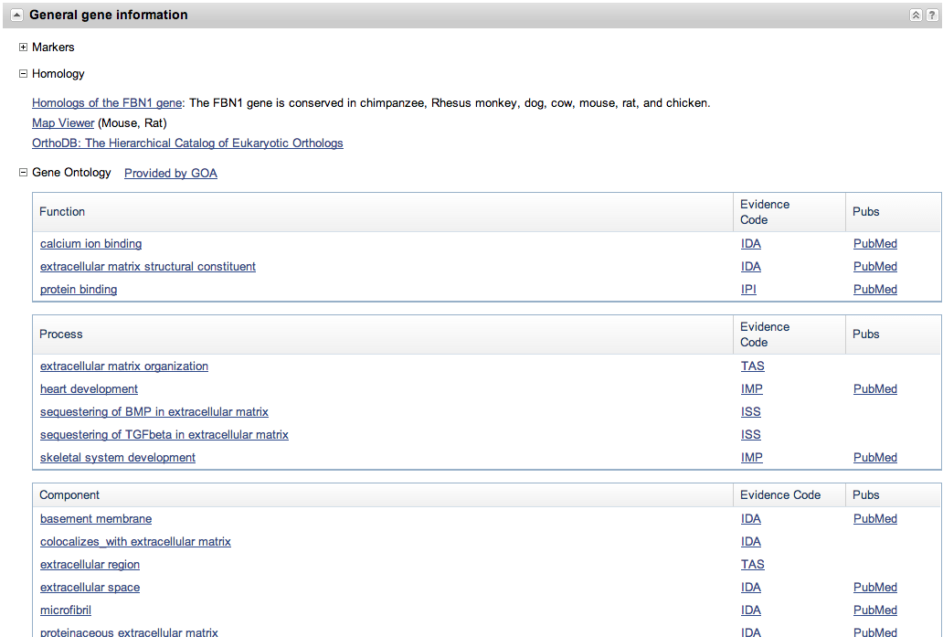
3. What are the Gene Ontology terms associated with your gene?
Scroll down on the NCBI Gene page until you reach the ‘general information’ section

Slide 11
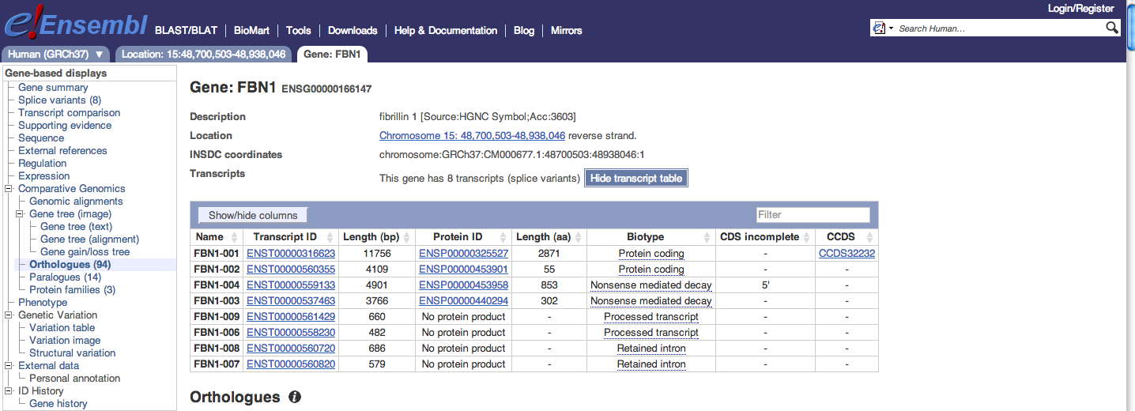
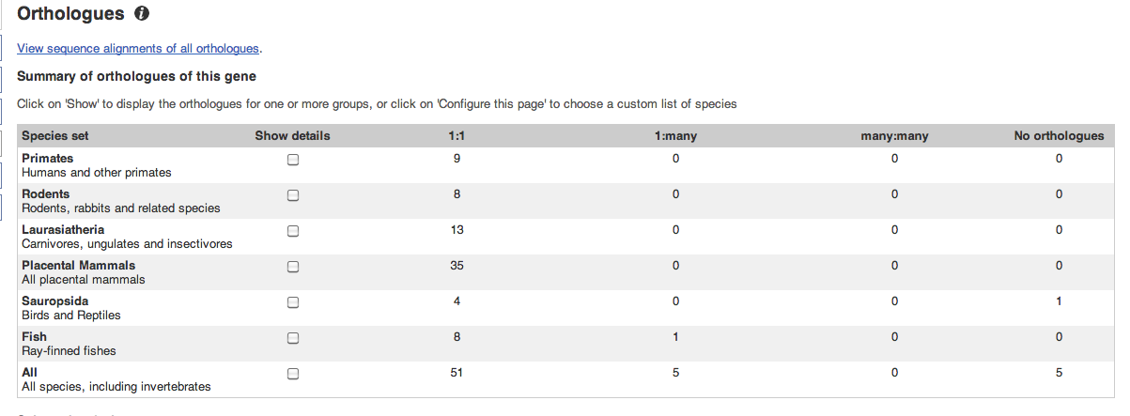
4. What is the name of the mouse homolog of your gene?
Go to ortologs on NCBI or follow the link to the ensemble page of your gene. There you can click on the section ‘orthologues’ to get all information about the homologs of your gene

Slide 12
4. What is the name of the mouse homolog of your gene?
Follow the link to the ensemble page of your gene. There you can click on the section ‘orthologues’ to get all information about the homologs of your gene
The mouse homolog is also called Fbn1
6. Are there any invertebrate homologs?
Fruit fly is one of the examples of an invertebrate species in which a homolog is present

Slide 13
5. How many publications are there for your gene in human? In mouse
Scroll down on the NCBI Gene page until you reach the ‘Bibliography’ section
Human
Mouse

Slide 14
Step 3: Visualization of your gene in a genome browser
· Go to UCSC Genome Browser and find your gene.

Slide 15
1. How many exons does your gene have? Don't count, find where it's written,
On the gene page of UCSC you can find this information. Note that the page shows information for only one transcript. If a gene has alternative transcripts, look at all possible counts
Transcript 1: Total exon count 66
Transcript 2: Total exon count 30

Slide 16
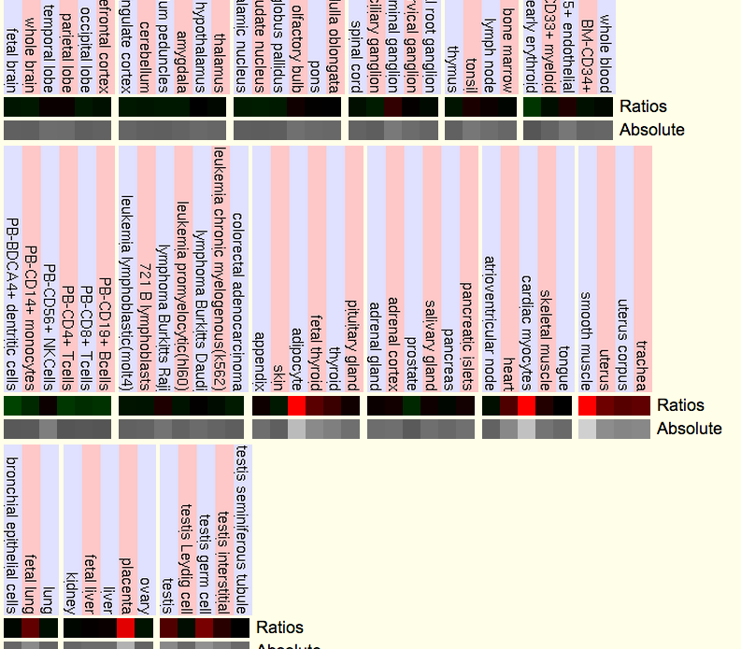
2. Look at the expression of your gene, does it correspond with your previous results?
scroll down further on the UCSC gene page to the ‘microarray expression data’ section . As you can see, the highest expression of FBN1 is measured in the same tissues as BioGPS mentions

Slide 17
3. What is the name of the 2 neighboring genes?
Zoom out and look for the genes surrounding your gene. Here these genes are DUT and CEP152

Slide 18
4. Open the conservation tracks, which parts of the gene show have high conservation?
Scroll down until the ‘comparative Genomics’ section. Put conservation track on “full” and press refresh
Focus on your gene and zoom in on the first part. You can see that the high conservation peaks correspond with the exons of FBN1.

Slide 19
END

